Slide 1


<Name>
<Date>

Slide 2

Outline
Executive Summary
Introduction
Methodology
Results
Conclusion
Appendix

Slide 3
Executive Summary
Summary of methodologies
Data Collection
Data Wrangling
Data exploration and analysis
Predictive modeling
Summary of all results
The data was pre-processed and analysed, using statistical and visual tools
Classification models were developed
Presenting the results

Slide 4
Introduction
Project background and context
Falcon 9 was developed by SpaceX with the main purpose of reusing its parts. This will drastically reduce the costs of space exploration while making it more reliable for people and payloads.
Problems you want to find answers
The goal is to build a model that can help us as a company to determine what aids in getting a succesfull landing.

Slide 5


Slide 6
Methodology
Executive Summary
Data collection methodology:
the data was collected with the help of SpaceX API and Wikipedia scrapping
Perform data wrangling
Feature extraction and transforming using python libraries
Create new data to improve models accuracy
Perform exploratory data analysis (EDA) using visualization and SQL
Perform interactive visual analytics using Folium and Plotly Dash
Perform predictive analysis using classification models
Few classification models were build and tested to choose the best one

Slide 7
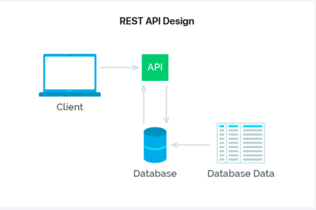
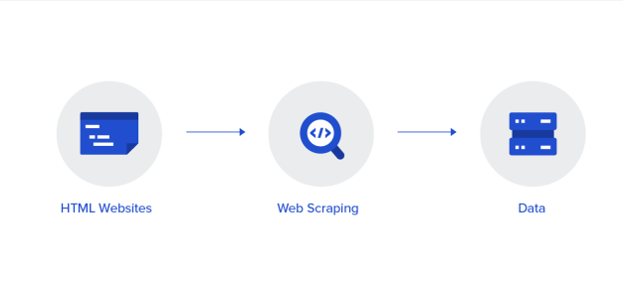
Data Collection
Using the SpaceX API, you can access data without using any credentials.
Also, to get more useful data, web scrapping was performed on the Wikipedia page

Slide 8
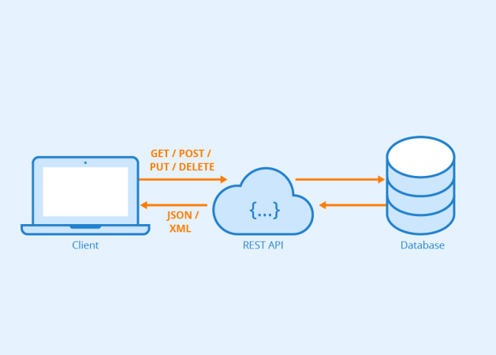
Data Collection – SpaceX API
The result of the API is a JSON file that was transformed into a Data Frame
The code used cand be found here:
https://github.com/AndreiToma89/coursera-capstone-project/blob/master/capstone.ipynb

Slide 9

Data Collection - Scraping
using the beautifulsoup python library, additional data was collected
The code for this operation can be found here:
https://github.com/AndreiToma89/coursera-capstone-project/blob/master/Data%20Collection%20with%20Web%20Scraping%20.ipynb
Place your flowchart of web scraping here

Slide 10
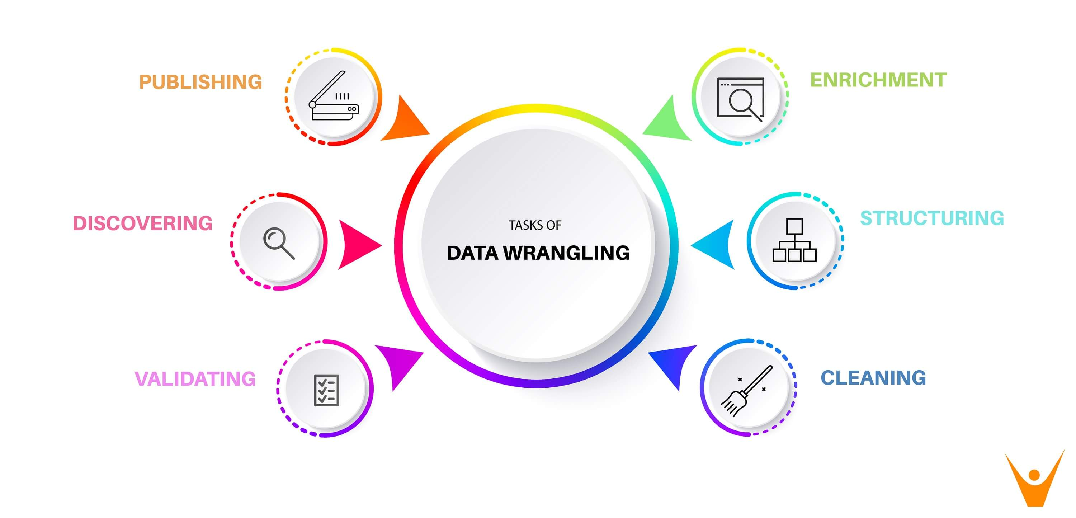
Data Wrangling
The collected data was preprocessed. The methods involved were replacing missing values, feature extraction and addition of new columns
https://github.com/AndreiToma89/coursera-capstone-project/blob/master/Data%20Wrangling.ipynb

Slide 11
EDA with Data Visualization
A number of charts were created to highline the correlation between data. The visual representation of the data was more initiative in explain few findings as well as finding important features
https://github.com/AndreiToma89/coursera-capstone-project/blob/master/Eda%20with%20Visualisation.ipynb

Slide 12
EDA with SQL
Using SQL we could dive more into the data and we could extract more valuable information.
GitHub URL: https://github.com/AndreiToma89/coursera-capstone-project/blob/master/Eda%20with%20SQL.ipynb

Slide 13
Build an Interactive Map with Folium
An interactive map with Folium was developed to help understanding the data with graphs and maps. The map shows circular marks for each site with color coding depending on the outcome.
Adding the markers and marking points on the map, help in visualize the data better in the geo contex.
GitHub URL: https://github.com/AndreiToma89/coursera-capstone-project/blob/master/Folium.ipynb

Slide 14
Build a Dashboard with Plotly Dash
Adding an interactive dashboard was the next step in exploring the data better. Each user can get their desired visualizations, in order to extract valuable information and insights.
GitHub URL: https://github.com/AndreiToma89/coursera-capstone-project/blob/master/Dashboard.ipynb

Slide 15
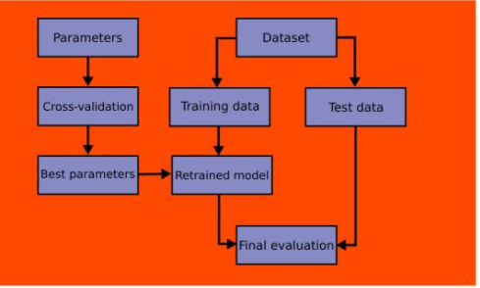
Predictive Analysis (Classification)
In order to get the best result, several classification models were created, and, combined with the power of a Grid Search, we could find the best nodel for our data.
GitHub URL: https://github.com/AndreiToma89/coursera-capstone-project/blob/master/ML%20prediction.ipynb

Slide 16
Results
EDA showed that orbit, launch site, payload and the number of flight were significantly correlated with the outcome.
All the models had almost the same accuracy, having the highest accuracy of the models at 83%

Slide 17


Slide 18
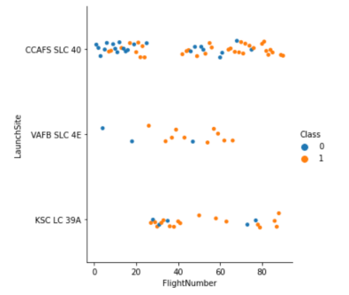
Flight Number vs. Launch Site
There is a string correlation between the number of flights and the success rate
We have no connection between launch location and the success rate

Slide 19
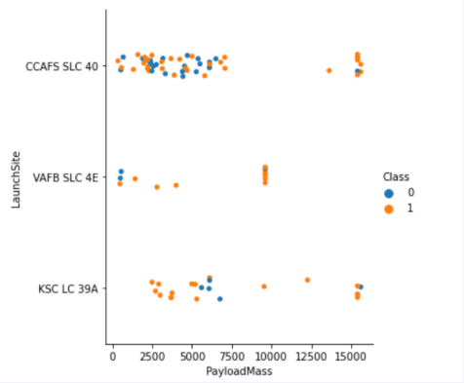
Payload vs. Launch Site
There's a slight correlation between payload and outcome

Slide 20
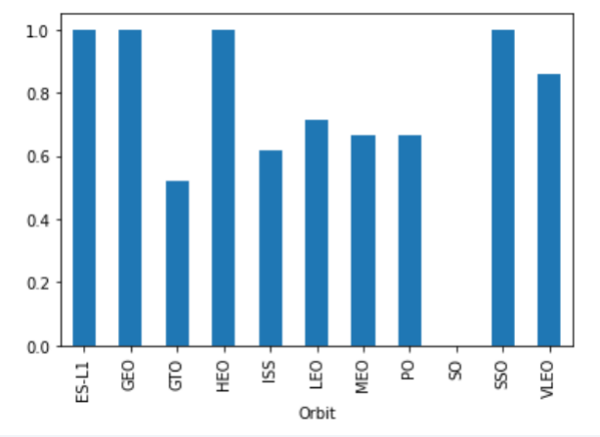
Success Rate vs. Orbit Type
The graph illustrates the success rate by orbit. We can observe that few of them have a high success rate.

Slide 21
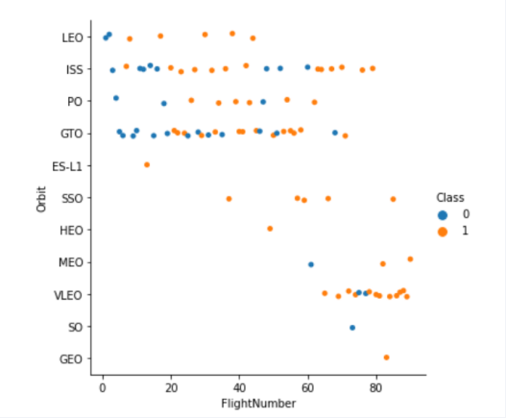
Flight Number vs. Orbit Type
This graph again shows increased success rate with increased flight number. The VLEO has good success rate partly due to increased flight number

Slide 22
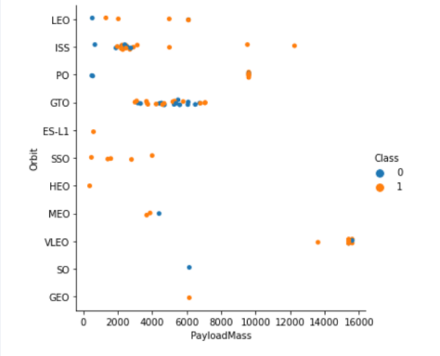
Payload vs. Orbit Type
The plot shows the success rate per PayloadMass and orbits. There's an invers correlation between pay load and success rate.

Slide 23
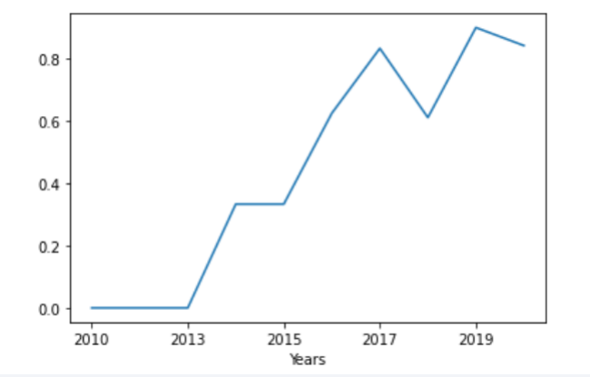
Launch Success Yearly Trend
As expected, the success rate is higher as the time goes.

Slide 24
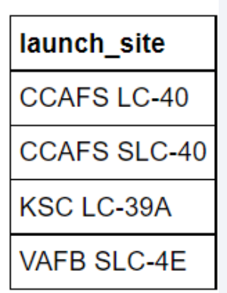
All Launch Site Names
These are the four launch sites

Slide 25
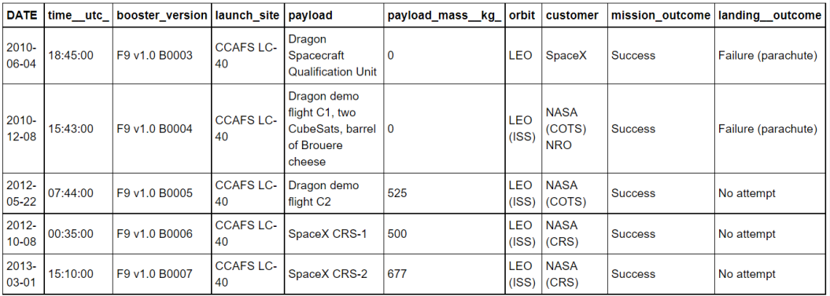
Launch Site Names Begin with 'CCA'
Above we have the top 5 rows of the launch site "CCA"

Slide 26
Total Payload Mass
The total payload carried for NASA was 45596 kg. This might be an important figure which can be asked while estimating cost and profitability

Slide 27
Average Payload Mass by F9 v1.1
The average payload mass carried by F9 v1.1: 2534 kg. The new version has improve payload carrying capacity.

Slide 28
First Successful Ground Landing Date
The date of the first successful landing was: 2015-12-22.

Slide 29
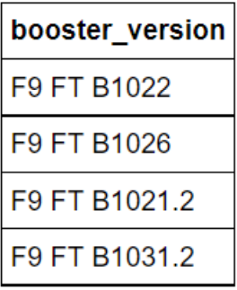
Successful Drone Ship Landing with Payload between 4000 and 6000
In this list we have the boosters with a payload between 4000 and 6000

Slide 30
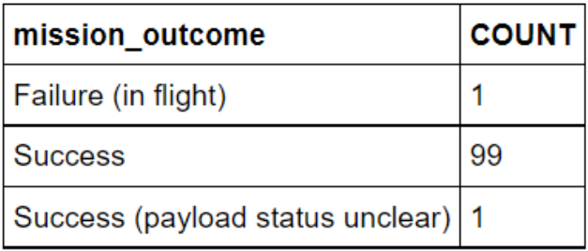
Total Number of Successful and Failure Mission Outcomes
The result of each mission outcome is presented below.

Slide 31
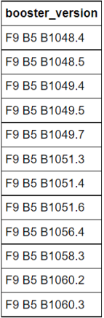
Boosters Carried Maximum Payload
These are the names of the boosters carried with maximum payload mass

Slide 32
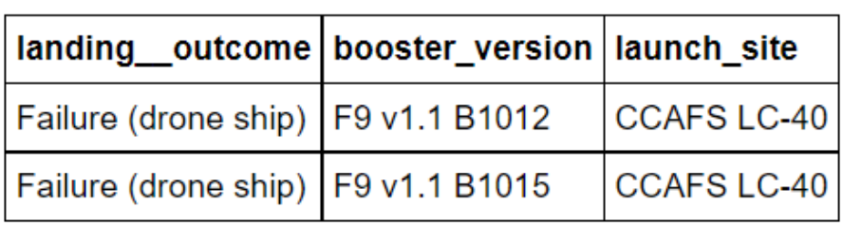
2015 Launch Records
This is how 2015 was for us in terms of landing outcomes, boosters and launch sites.

Slide 33
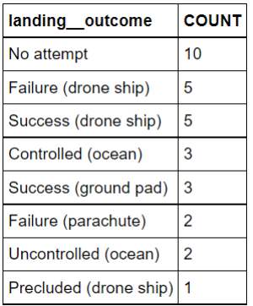
Rank Landing Outcomes Between 2010-06-04 and 2017-03-20
The total count of landing outcomes in for dates between 2010-06-04 and 2017-03-20

Slide 34


Slide 35
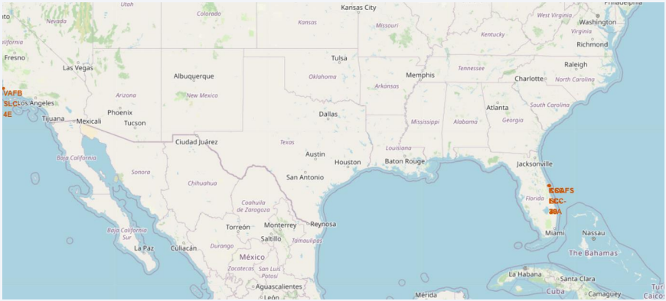
<Folium Map Screenshot 1>
Here we have displayed all our launch sites

Slide 36
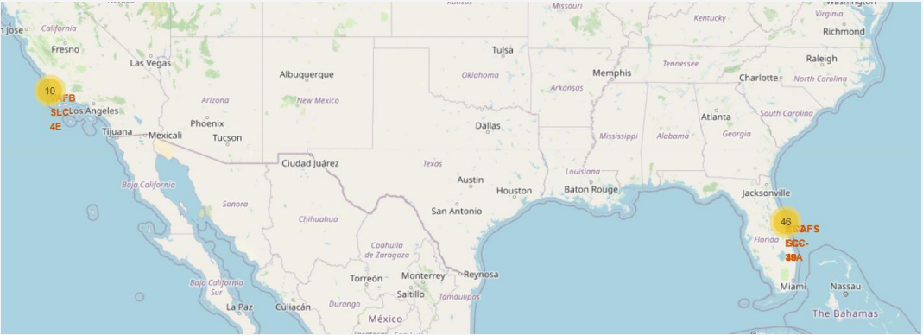
<Folium Map Screenshot 2>
As we can see, 46 launches were made in the east while only 10 in west

Slide 37
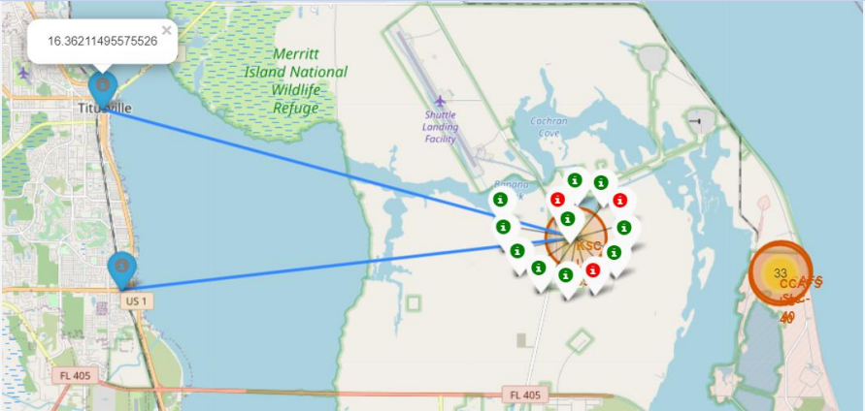
<Folium Map Screenshot 3>
Clic pentru a adăuga text
Above you can see which sites hada successful landing (in green) and which not(in red)

Slide 38


Slide 39
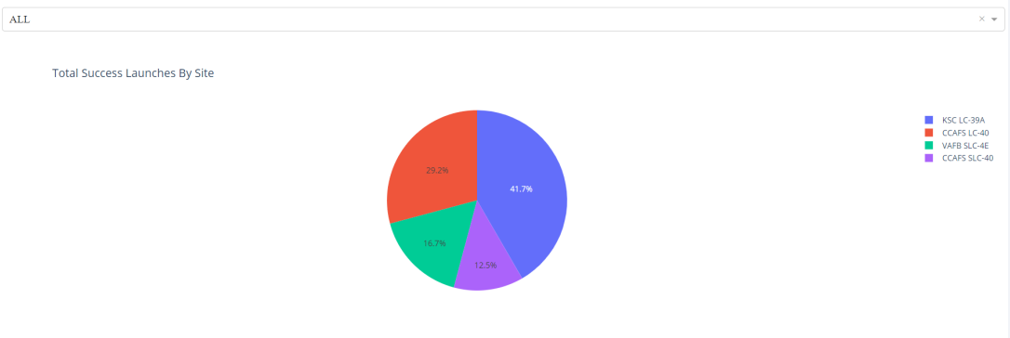
<Dashboard Screenshot 1>
In the above piechart we have the succesful rate per each launch site

Slide 40
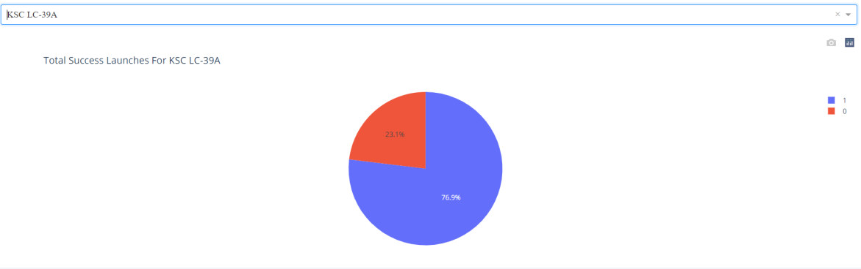
<Dashboard Screenshot 2>
The above piechart displays the success rate only for one launch site

Slide 41
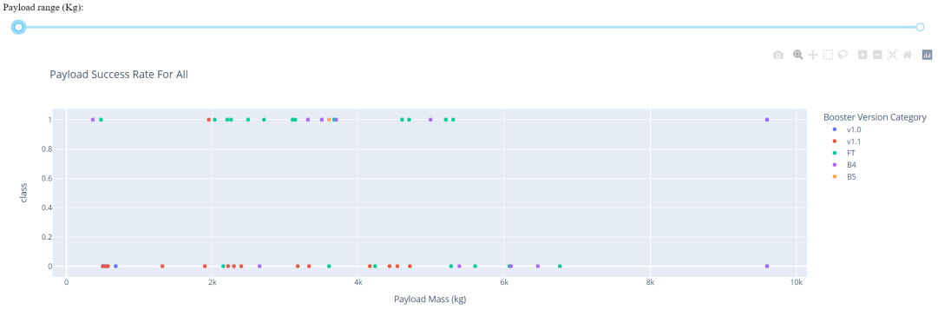
<Dashboard Screenshot 3>
Replace <Dashboard screenshot 3> title with an appropriate title
Show screenshots of Payload vs. Launch Outcome scatter plot for all sites, with different payload selected in the range slider
Explain the important elements and findings on the screenshot, such as which payload range or booster version have the largest success rate, etc.
Payload vs success rate plot

Slide 42


Slide 43
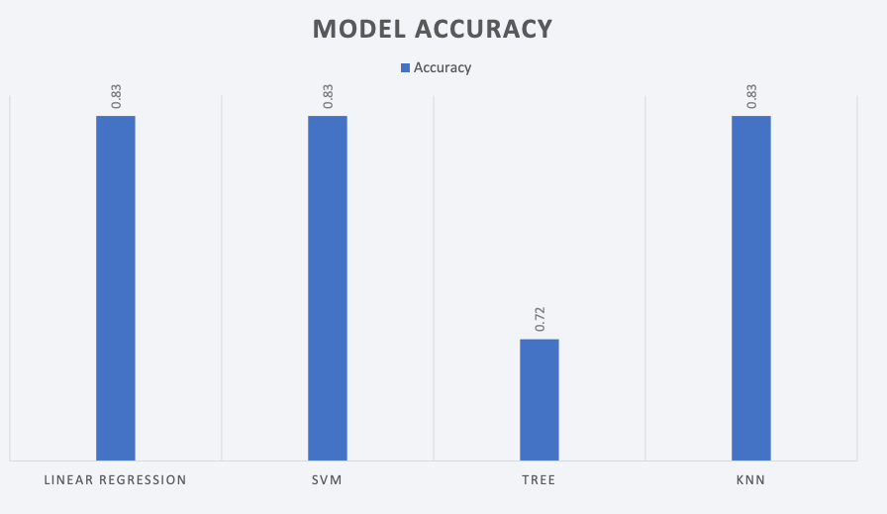
Classification Accuracy

Slide 44
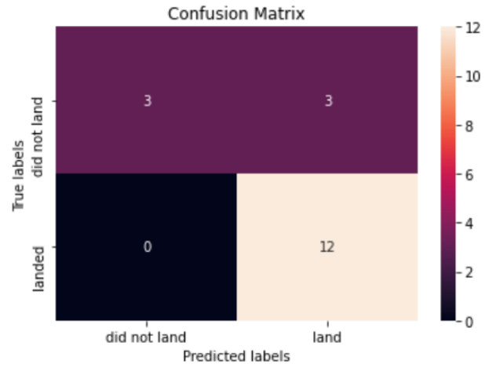
Confusion Matrix
Confusion matrix showing true positive, false positive, true negative and false negative in numbers

Slide 45
Conclusions
With predictive modelling technique, we predicted success rate of SpaceX launch outcome with 83% accuracy.
• The insights obtained were
1. lower payload increased the success rate. However, payload is also linked to profitability. We have to come up with a optimal payload for acceptable success rate (assuming that rest of the parameters are constant). Another way is to retest the hypothesis with new technology and invasion
2. effect of orbits on success rate
3. launch site related features. Are there any room for improvement?

Slide 46
Appendix
All the code and notebooks are available on :
https://github.com/AndreiToma89/coursera-capstone-project

Slide 47


